Slide 1
Connected Care project guide
Dr Benjamin McElwee
Orthopaedic Registrar

Slide 2
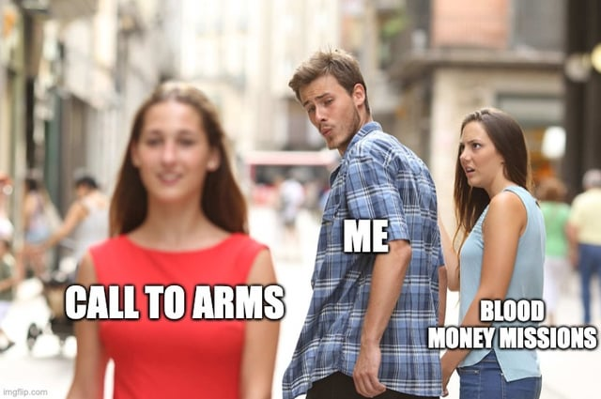
Unaccredited registrars
Not doing PROMS f/u calls

Slide 3
What to do?
Aim to call at least 5 patients per week in order to keep up top date with patients who have returned PROMs
Decide on 1 of 4 options:
  Keep current appointment (if needing further review and has an appointment)
  No Appointment needed (if not needing further review and already discharged)
  To be discharged (if not needing further review but still has appt)
  New appt to be booked (if needing further review but has been discharged)
Document on Sunray database and EMR

Slide 4
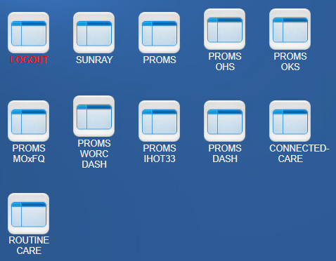
What to do
Log in to Sunray
  ortho
  orthoreg
Click the “CONNECTED CARE" tab

Slide 5
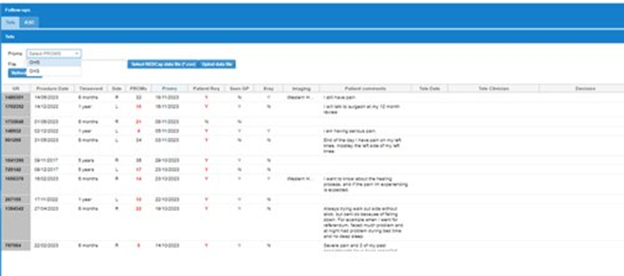
What to do
Click the "Tele" tab at the top (not "ASC")
Click either "OHS" (hip) or "OKS" (knee) from the drop-down list then hit “Click to refresh table”

Slide 6
What to do
Pick a patient who does not already have a decision.
Call the patient, can be brief
Document on Sunray:
  date you called them (Tele Date)
  who called them (Tele)
  your decision (Decision)
There is also a "Clinician comments" column in which you can add any more information if needed (this is for the admin staff only, clinical information should be input to Cerner)

Slide 7
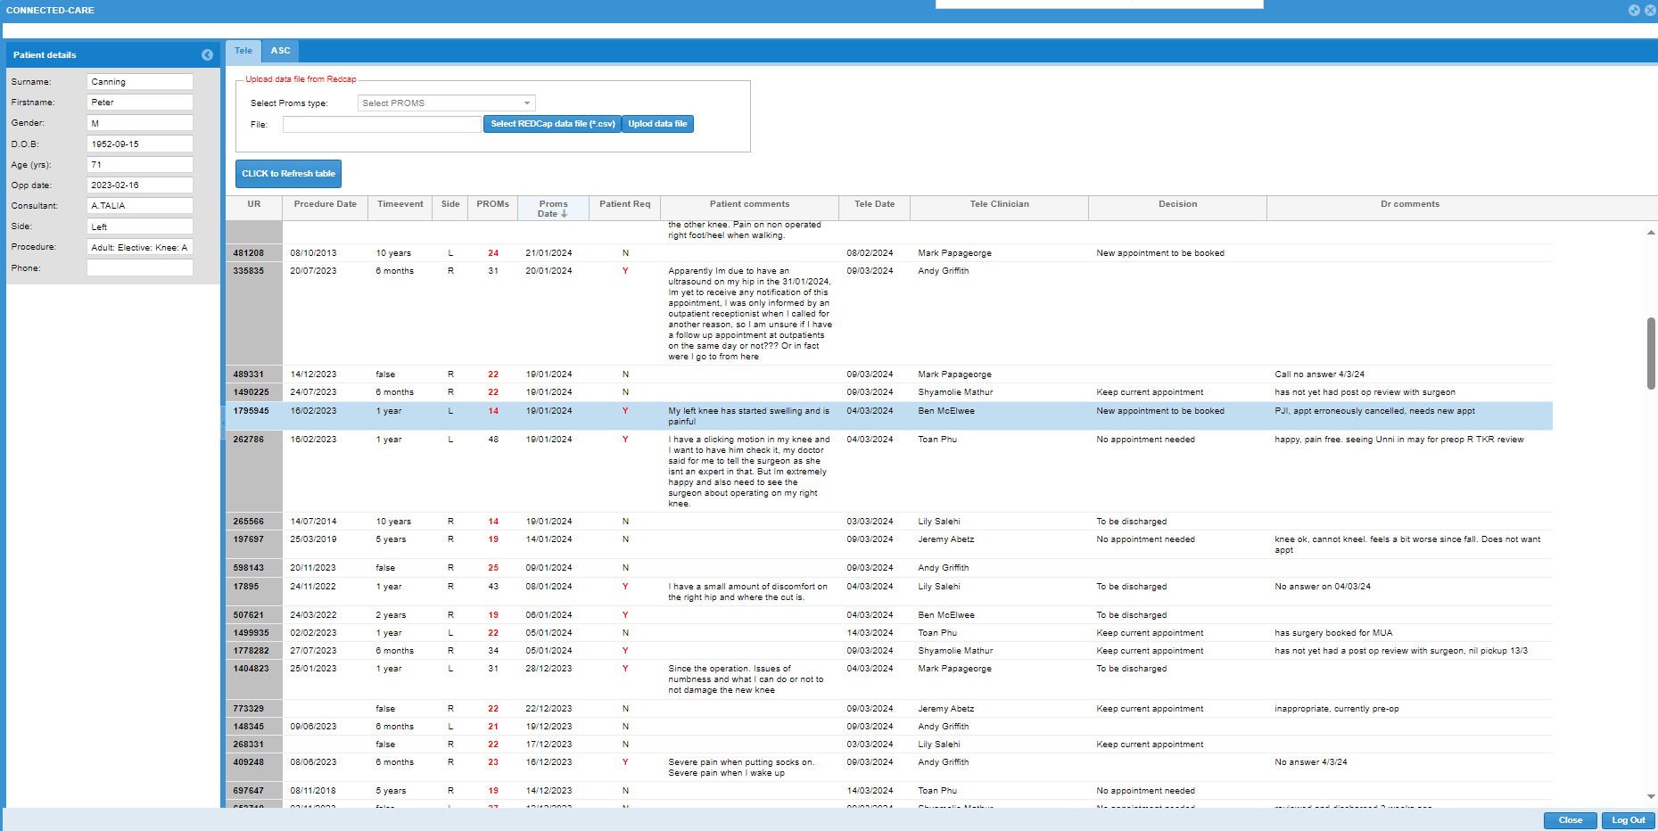
What to do
Useful information in the circles
Document information under the arrows

Slide 8
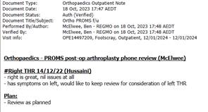
What to do
Document a brief EMR note.
Request further appointment if needed.
Admin team will then action your decision.

